Slide 1
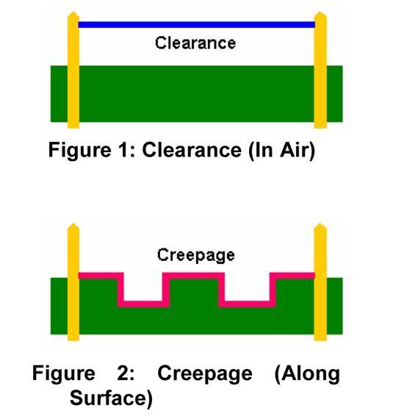
Insulation Design Overview: Clearance and Creepage
Clearance: shortest path between two conductive parts,
measured through air
Creepage: shortest path between two conductive parts,
measured along the surface of the insulation
How to look up clearance and creepage requirements?
International standard: IEC 60950
National standard of USA and Canada: UL 60950 (based on IEC 60950)
In PCB design, clearance can be obtained in IPC-2221B
How to make sure that the requirements are satisfied?
Talk with UL and get the converter certified by UL
Standard for Safety of Information Technology Equipment- Part 1: General Requirements, UL 60950-1, 2007.
Generic Standard on Printed Board Design, IPC-2221B, 2012.
Notes:
There is no creepage requirement in IPC-2221 B standard

Slide 2
Insulation Design: Types of Insulation
Different types of insulation based on UL 60950
Functional insulation: insulation that is necessary only for correct functioning of equipment (no protection against electric shock)
Basic insulation: insulation to provide basic protection against electric shock
Supplementary insulation: independent insulation applied in addition to basic insulation in order to reduce the risk of electric shock in the event of a failure of the basic insulation
Double insulation: insulation comprising both basic insulation and supplementary insulation
Reinforced insulation: single insulation system that provides a degree of protection against electric shock equivalent to double insulation
Different types of insulation are required for different cases according to UL 60950
Hazardous voltage: voltage exceeding 42.4 V peak, or 60 V dc

Slide 3
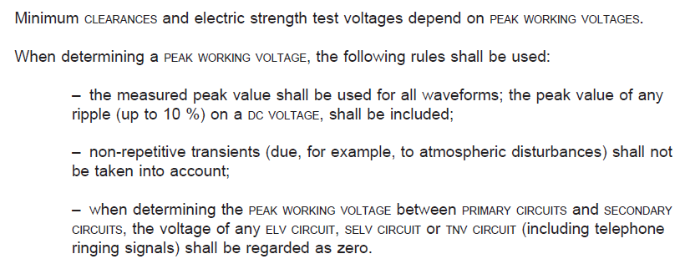
Clearance
CLEARANCES shall be so dimensioned that overvoltages, including transients, which may enter the equipment, and peak voltages which may be generated within the equipment, do not break down the CLEARANCE
Common clearance requirements from UL 60950 only apply for equipment to be operated up to 2000 m above sea level
Clearance requirements for >2000 m above sea level operation: refer to IEC 60664-1
Standard for Safety of Information Technology Equipment- Part 1: General Requirements, UL 60950-1, 2007.

Slide 4
Clearance Requirements from IPC-2221B
Seven categories to consider
Bare PCB board
B1-internal conductor: between internal conductors or internal conductor and via/plated hole
B2: external conductor, uncoated, sea level to 3050 m (10007 feet)
B3: external conductor, uncoated, over 3050 m (10007 feet)
B4: external conductors, with permanent polymer coating (Any Elevation)
PCB assembly
A5: external conductors, with conformal coating over PCB assembly (Any Elevation)
A6: external component lead/termination, uncoated, sea level to 3050 m (10007 feet)
A7: external component lead/termination, with conformal coating (Any Elevation)
Notes
A5: conformal coating after PCB assembly, mainly for military applications
B4/A6 combination: most common in commercial, nonharsh environment applications

Slide 5
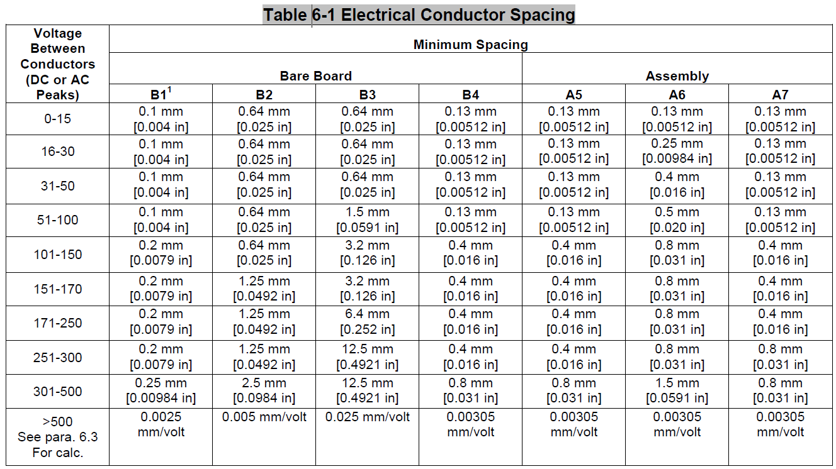
Clearance Requirements from IPC-2221B
Notes:
There is only 0.7 mm difference between B4 and A6 requirements

Slide 6
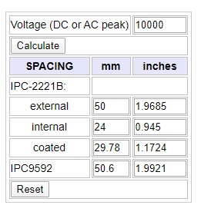
Tips in Designing Clearance
Two tips to reduce clearance requirement
Try to use the internal conductor
Use coating material
Examples:
Minimum clearance for type B1 board with 600 V
Minimum clearance for 10 kV DC for different type of PCB
Minimum clearance for B4/A6 combination: 30.5 mm
Minimum clearance without any coating: 50 mm (B2)
Online calculator results:
PCB type | B1 | B2 | B3 | B4 | A5 | A6 | A7
Clearance (mm) | 24 | 50 | 250 | 29.8 | 29.8 | 30.5 | 29.8
https://www.smps.us/pcbtracespacing.html
Notes:
If you use coating material, you can switch from B2 to B4

Slide 7
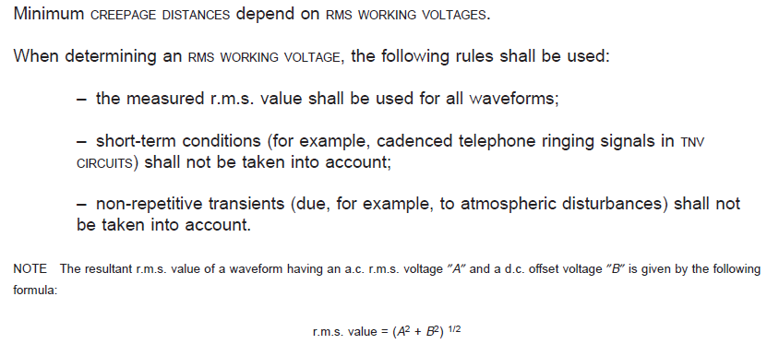
Creepage and Tracking
Tracking: electrical breakdown on the surface of an insulating material where a conductive leakage path is formed due to electrical stress, humidity, and contamination
Comparative tracking index (CTI) is used to measure the tracking property of an insulating material
CTI of an insulating material can be tested based on IEC 60112
CREEPAGE DISTANCES shall be so dimensioned that, for a given RMS WORKING VOLTAGE and pollution degree, no flashover or breakdown of insulation (for example, due to tracking) will occur.
N. Parkman, "Tracking in insulation," Journal of the Institution of Electrical Engineers, vol. 8, no. 90, pp. 280-283, June 1962.
Notes:
Creepage requirement is designed to avoid tracking

Slide 8
Creepage Requirements from UL 60950
Creepage requirements are dependent on RMS working voltage, material group and pollution degree
Pollution degrees are classified as follows
Pollution Degree 1: no pollution, or only dry and non-conductive pollution
Pollution Degree 2: only non-conductive pollution that might temporarily become conductive due to occasional condensation
Pollution Degree 3: conductive pollution, or dry non-conductive pollution which could become conductive due to expected condensation
Material groups are classified based on CTI
CTI of conventional FR4 material: from 175 to 249 (Group IIIa)
CTI values can be found in datasheet of other PCB dielectric materials

Slide 9
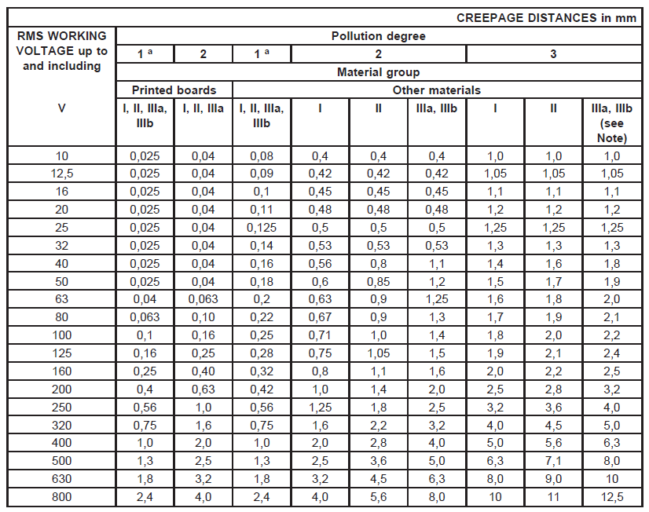
Creepage Requirements from UL 60950

Slide 10
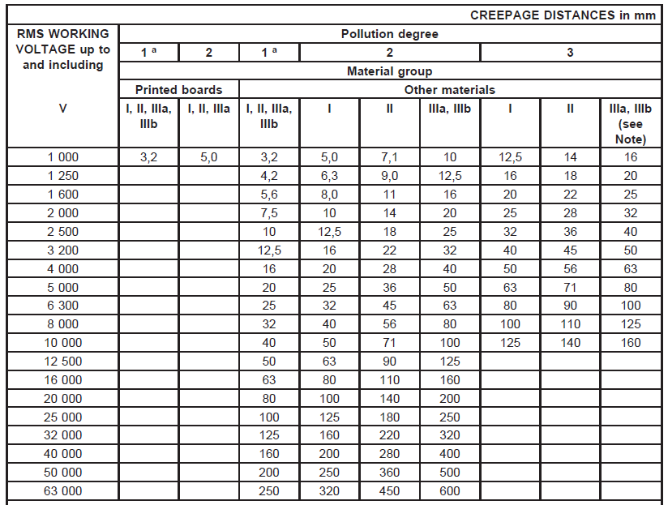
Creepage Requirements from UL 60950
Linear interpolation is allowed between the two nearest points
Values should be 2X those in the table for reinforced insulation

Slide 11
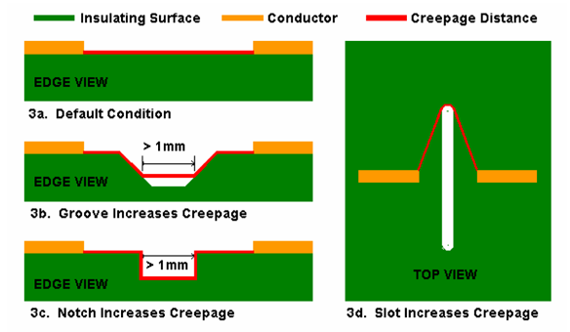
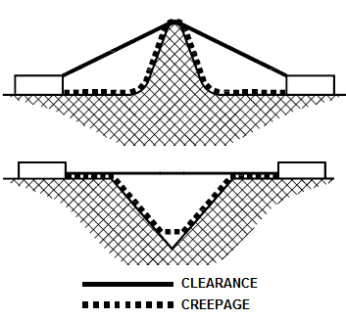
Tips in Designing Creepage
Two tips to reduce creepage distance requirement
Add slots, notches, or grooves
Use coating with higher CTI
Examples
Minimum creepage for 10 kV RMS for different cases
Pollution Degree 1: 40 mm
Pollution Degree 2, material group I: 50 mm
Pollution Degree 2, material group II: 71 mm
Pollution Degree 2, material group IIIa or IIIb: 100 mm
Typically required creepage is longer than required clearance
10 kV DC for B4/A6 combination: 30.6 mm clearance, 71 mm creepage
Usually satisfy clearance requirement first, and then add slots or grooves
Based on UL 60950, if creepage distance is less than clearance, the clearance
shall be the required creepage distance
https://pcbdesign.smps.us/creepage.html

Slide 12
Z-axis Insulation in PCB Design
IPC-2221B: for Z-axis spacing considerations, use the dielectric breakdown of the specific material
Dielectric breakdown strength of PCB dielectric material shrinks as time goes by
High dv/dt of PWM voltage accelerates the aging of PCB dielectric material, requiring more design margin and better PCB dielectric material
Material Type | Max. Operating Temperature (°C) | Voltage (V/mil) | Aged rating (V/mil)
FR4 | 105-130 | 800 | 150-300
FR4-High Temp | 130-150 | 800 | 150-300
BT-Epoxy | 140-160 | 1300 | 400-600
Polyimide | 150-190 | 900 | 500-700
B. Florkowska, M. Florkowski, J. Roehrich, and P. Zydron, “The influence of PWM stresses on degradation processes in electrical insulation systems,” Annual Report Conference on Electrical Insulation and Dielectic Phenomena, Oct 2010, pp. 1–4.
Notes:
Sometimes we also need to consider Z-axis insulation in PCB design, which is also critical if we want to design busbar, PCB busbar or laminated busbar. We do not want to have any insulation issues here. In order to have more confidence, FEM is necessary.

