Slide 1
DSP Tutorial
Version | Date | Author | Notes
1.0 | Jan, 2014 | Yiwei Ma | First version; Suitable for DSP 28335 and CCS 5.0
1.1 | July, 2018 | Yiwei Ma | Modified template, adjusted slide sequence, Added instructions to the sample code

Slide 2
DSP
Getting Started
  Hardware introduction: DSP 28335 CPU and peripherals
  Software introduction: CCS 5
    Project Structure Example
    Build a New Project
    Basic Knowledge for Debugging
DSP Programming
  Program Sequence
  Configure the DSP – Registers and Memory
    PWM, Interrupts
    Memory and CMD File
    External Interface (with ADC, FPGA, etc)
    Start from Flash
  Tips Based on Experiences
    Useful Tools Provided by CCS
    Programming Tips
Debugging with Converter – A Flowchart

Slide 3
DSP Hardware introduction
Digital Signal Processor
  Texas Instrument DSP TMS320F28335
  Not the most advanced one, but majority of people still use it.
Parameters |  | Specs
Processor | CPU clock | 150 MHz, (6.67 ns Cycle Time)
Memory | RAM | 68 kB
 | Flash | 512 kB
PWM | PWM Channels | 6 ePWM modules, 12 output channels
 | High Resolution PWM Channels | 6 HRPWM Outputs With 150 ps MEP Resolution

Slide 4
DSP Hardware introduction
Parameters |  | Specs
A/D converter | Channels | 16
 | Resolution | 12 bit
 | Input voltage range | 0 ~ 3.0V
 | Conversion time | 80 ns
D/A converter | NO DAC on eZdsp F28335
Communications | USB | NO
 | RS-232 Serial port | 2
 | CAN bus port | 2
 | GPIO pins | 88
 | JTAG | 1

Slide 5


Programming tool — CCS
Code Composer Studio v5
  Based on Eclipse
Eclipse
  An integrated development environment (IDE). It contains a base workspace and an extensible plug-in system for customizing the environment.
  Very common IDE for JAVA

Slide 6
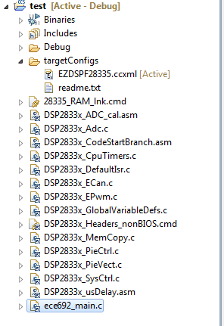
Project Structure Example
Project
name
Software generated files
Directory
For the header files
Target Configurations:
Tells the types of the DSP and emulator.
Produced programs
For DSP
Common source files:
Provide basic functions;
Usually the same for every projects.
User defined files:
Determine the functions of the project;
Can be more than one file.

Slide 7
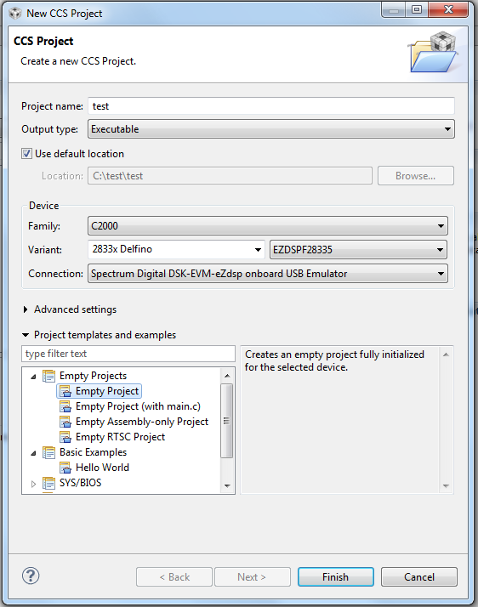
New Project
Output type: Executable
Family: C2000
Variant: 2833x Delfino
EZDSPF28335
Connection: Spectrum Digital
DSK-EVM-eZdsp onboard
USB Emulator
Empty Project

Slide 8
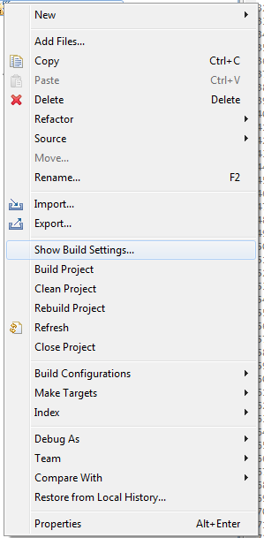
Add Source Codes to The Project
All files under “Source Code” folder
Copy or Link? Personal preference
Copy:
  You have your own copy of the codes.
  No need to worry about making change to the original files.
  Delete from workspace will delete it on your hard drive. Please backup your codes.
Link:
  The linked file is changed once you modify it.
  Easy to share your modification between projects.
  May cause problem if others are not aware of the change.
  Delete from workspace will NOT affect the original file.

Slide 9
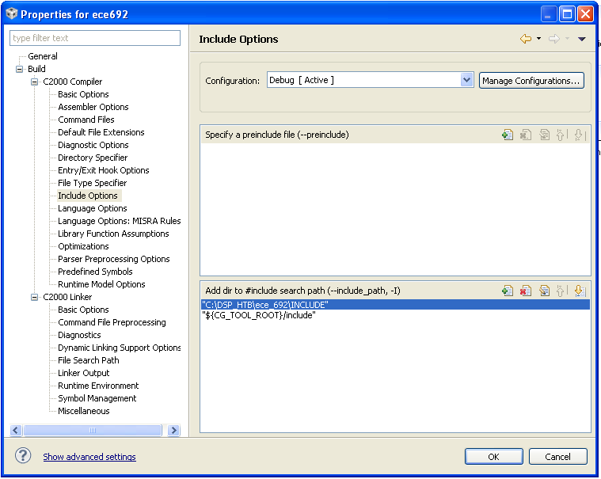
Add Search Path for Header File
Filesystem -> Your header file directory
“Include” folder

Slide 10

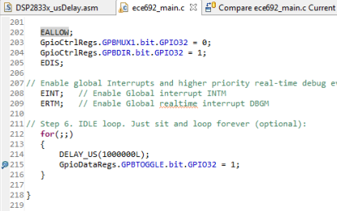
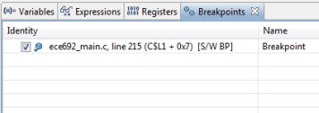
Compile and Run
Someone may need to add a
“CCS Debug” perspective
Most don’t.
Debug
(Automatically compile, build
and load programs into DSP)
Double click here to create a breakpoint
Run continuously
(or to the next breakpoint)
To check all breakpoints you set

Slide 11
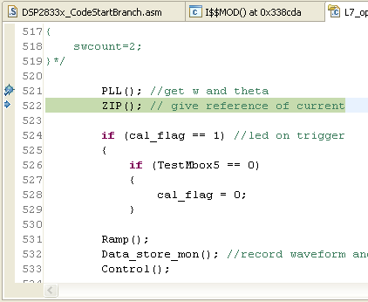
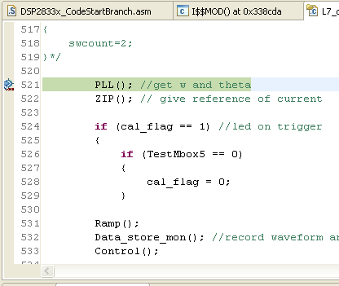
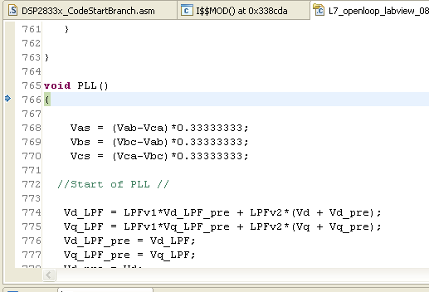
Debug - Run the Program
Leave Debug
Restart
Program
Step over
Step return
Step into

Slide 12
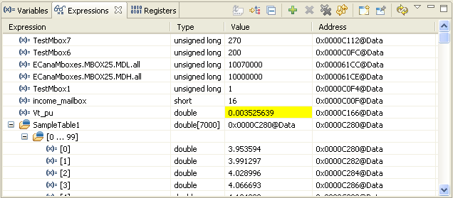
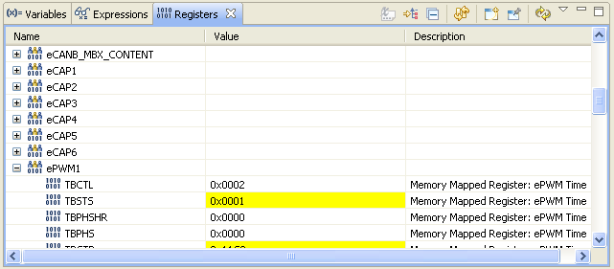
Debug - Observing Variables
Expression Tab
to check variables
Yellow background indicates value
different from previous.
You can also check value of an expression
(e.g. Vt_pu*100=0.35…)
Register Tab
to check registers

Slide 13
DSP Programming
Program Sequence
Configure the DSP – Registers and Memory
  PWM, Interrupts
  Memory and CMD File
  External Interface (with ADC, FPGA, etc)
  Start from Flash
Tips Based on Experiences
  Useful Tools Provided by CCS
  Programming Tips

Slide 14
Program Sequence

Slide 15
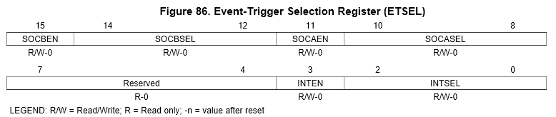
Configure the DSP – Registers
Example: Enable ePWM1 interrupts
void InitEPwmTimer()
EPwm1Regs.ETSEL.bit.INTEN = PWM1_INT_ENABLE; // Enable INT
EPwm1Regs.ETSEL.bit.INTEN = 1; // Enable INT
EPwm1Regs.ETSEL.all |= 0x0008; // Enable INT
Defined as 1 at top of the program
Others can be found in related header files

Slide 16
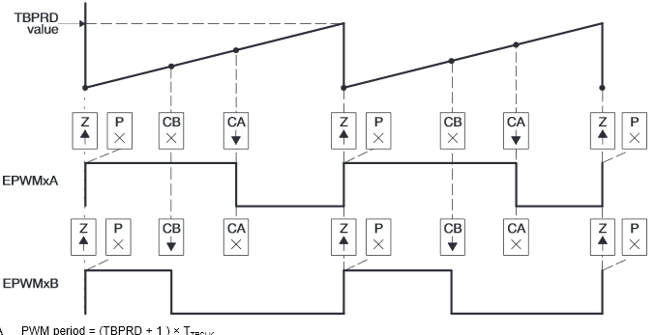
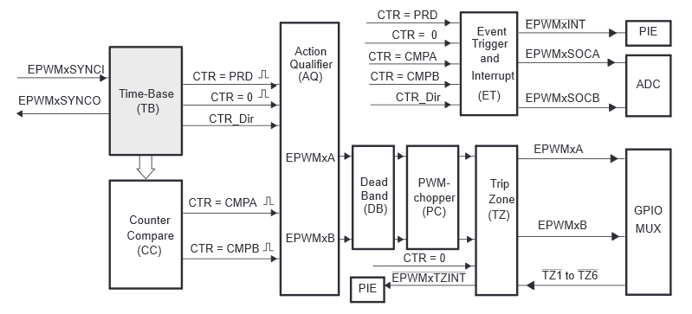
ePWM – Configuration
TBCTR: Counter
Carrier Wave
TBPRD: Period
TBCTL.bit.CTRMODE: Shape
Modulation Wave
CMPA: Switch A (Lower)
CMPB: Switch B (Higher)
TB: Carrier Wave
CC: Modulation Wave
AQ: Set / Toggle Output PWM
DB: Generate Dead Band
PC: Generate High Freq. Pulses
TZ: Respond When Fault
ET: Trigger ADC or Interrupts
http://www.ti.com/lit/ug/sprug04a/sprug04a.pdf

Slide 17
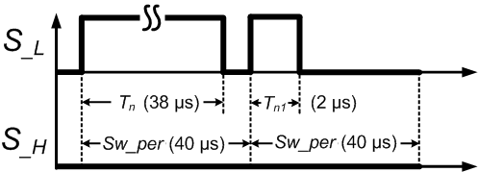
ePWM – Double pulse logic signal generator
If (Flag_DPT == 1) // Enable double pulse signal //
{
// Set double pulse parameter //
sw_per=5700; // Tn*150MHz (clock speed)
Tn=6000; // Sw_per*150MHz (clock speed)
Tn1=600; // Tn1*150MHz (clock speed)
// Generate the 1st pulse //
if (DPT_count == 1) // DPT_count is pulse # account, initial value is set to be 1
{
EPwm1Regs.TBPRD = sw_per; // set EPWM1 period
// set EPWM1A register for S_{_L} //
EPwm1Regs.CMPA.half.CMPA = Tn; // set EPWM1A comparator
EPwm1Regs.AQCTLA.bit.CAU = AQ_CLEAR; // set EPWM1A actions when counter equals the CMPA, force
EPWM1A output low
EPwm1Regs.AQCTLA.bit.ZRO = AQ_SET; // Initialize EPWM1A output, action when counter equals to 0, force
EPWM1A output high
// set EPWM1B register for S_{_H} (always low) //
EPwm1Regs.CMPB = 0; // set EPWM1B comparator//
EPwm1Regs.AQCTLB.bit.CBU = AQ_CLEAR; // set EPWM1B actions when counter equals the CMPA, force
EPWM1B output low
EPwm1Regs.AQCTLB.bit.ZRO = AQ_CLEAR; // Initialize EPWM1B output, action when counter equals to 0, force
EPWM1B output low
DPT_count=2; // prepared for the 2nd pulse//
}
Double pulse logic signal

Slide 18
ePWM – Double pulse logic signal generator
else // Generate the 2nd pulse //
{
if (DPT_count == 2)
{
EPwm1Regs.TBPRD = sw_per; // set EPWM1 period
EPwm1Regs.CMPA.half.CMPA = Tn1; // re-set EPWM1A comparator
EPwm1Regs.CMPB = 0; // set EPWM1B comparator
DPT_count = 3; // Complete double pulse signal generator//
}
else // After the 2nd pulse, disable PWM output
{
EPwm1Regs.TBPRD = sw_per; // set EPWM1 period
EPwm1Regs.CMPA.half.CMPA = 0; // re-set EPWM1A comparator
EPwm1Regs.AQCTLA.bit.ZRO = AQ_CLEAR; // Initialize EPWM1A output, action when counter
equals to 0 force EPWM1A output low
EPwm1Regs.CMPB = 0; // set EPWM1B comparator
}
}

Slide 19
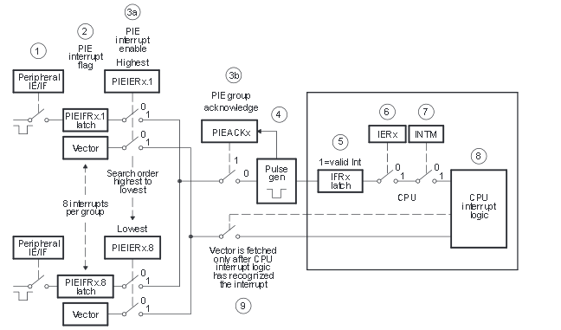
Interrupt – Configuration
For a successful interrupt, the following condition must be satisfied
Interrupt Enabled
PIEIER Enabled
PIEACK cleared
CPU Allow Interrupt
Event
Correct Interrupt
Function Address
http://www.ti.com/lit/ug/spru430e/spru430e.pdf
http://www.ti.com/lit/ug/spru566j/spru566j.pdf

Slide 20
HTB Program Sequence

Slide 21
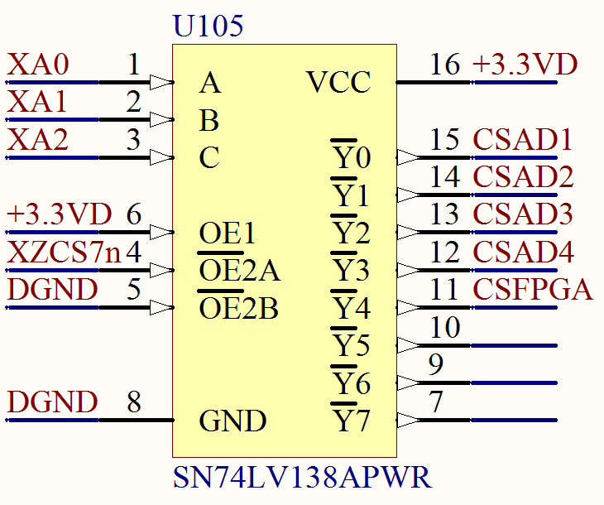
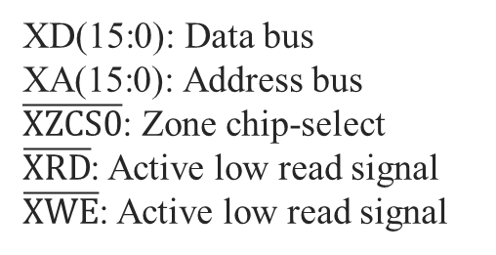


External Interface (XINTF) – Configuration
DSP can be connected to ADC, DAC, FPGA, etc.
Physical connection
If DSP interfaces with multi-external device, then the address from DSP should be decoded to the CS(Chip Selection) signals
XA
XD(15:0): Data bus
XA(15:0): Address bus
$\overline{XZCS0}$: Zone chip-select
$\overline{XRD}$: Active low read signal
$\overline{XWE}$: Active low read signal
$$\overline{CS}$$
$$\overline{XZCS7}$$

Slide 22
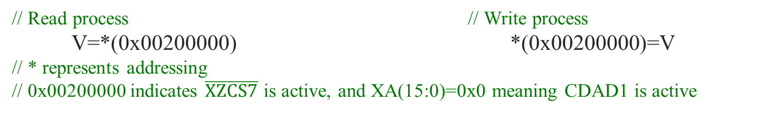
External Interface (XINTF) – Read/Write Process
// Read process // Write process
V=*(0x00200000) *(0x00200000)=V
// * represents addressing
// 0x00200000 indicates $\overline{XZCS7}$ is active, and XA(15:0)=0x0 meaning CDAD1 is active
The time for the lead/active/trail period can be set

Slide 23
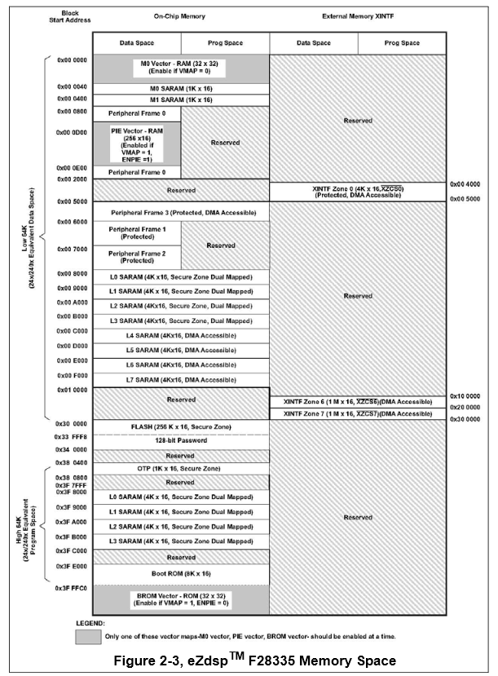
Memory and CMD File
Linker Command (CMD) file
  Helps Compiler to allocate the program into different part of the DSP memories.
MEMORY
{
PAGE 0 :
…
RAML1 : origin = 0x009000, length = 0x002000
…
}
SECTIONS
{
…
.text : > RAML1, PAGE = 0
…
}
(Define memory blocks)
(Tell which section goes to which block)

Slide 24
Memory and CMD File
Global vars (.ebss)
Init values (.cinit)
Section Name | Description
.text | Executable code and constants
.cinit | Initalized global and static variables
.econst | Constant data (e.g. const int k = 3;)
.switch | Tables for switch statements
.ebss | Global and static variables
.stack | Stack space
.esysmem | Memory for malloc type functions
.reset | Reset vector
int x = 2;
int y = 7;
void main(void)
{
long z;
z = x + y;
}
Local vars (.stack)
Code (.text)
http://www.ti.com/lit/ug/spru513g/spru513g.pdf
http://processors.wiki.ti.com/index.php/C28x_Compiler_-_Understanding_Linking

Slide 25
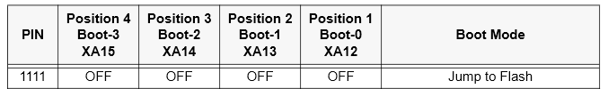
Start from FLASH
FLASH data will not be erased after the power loss:
No need to load program every time.
Procedure:
  Change CMD file, change “Boot Load Option Switch” on the development board
  Add “DSP2833x_MemCopy.c” to your project
  Put your calculation functions to RAM, in order to increase time efficiency
    #pragma CODE_SECTION(Your_Func_Name, "ramfuncs");
  Add following codes during initialization
    MemCopy(&RamfuncsLoadStart, &RamfuncsLoadEnd, &RamfuncsRunStart);
    InitFlash();
Example project can be downloaded from TI website.
Note that you can only have two breakpoints when using flash
http://www.ti.com/lit/an/spra958l/spra958l.pdf

Slide 26
What Could Go Wrong
If there are errors or warnings shown.
  Google it, or ask in forums
If there are no explicit errors, but running have problems, generally possible reasons are:
  Broken DSP / Bad configuration on CCS / Emulator
  Breakpoints do not work (Programs run well)
  Jumper on Development Board is not set correctly
  Related registers are configured wrong or didn’t manually clear after an event.

Slide 27
Links on help documents and resources
Official user guide
  http://www.ti.com/product/tms320f28335
Workshop presentation slides
  http://processors.wiki.ti.com/index.php/C2000_Archived_Workshops
Discussion forum
  http://e2e.ti.com/support/microcontrollers/c2000/f/171.aspx
Example projects
  http://www.ti.com/tool/sprc530

Slide 28
Discussion
How can you tell PWM1 interrupts triggers before PWM2 interrupts? Or vice versa?
How many methods can you think of to double the LED toggle time periods?

Slide 29
Useful Functions
Plot Graph from Cached Data
Save Cached Data
Compare with Local History
Memory Browser
Search All Files in Workspace
Useful Shortcut Keys
Clock

Slide 30
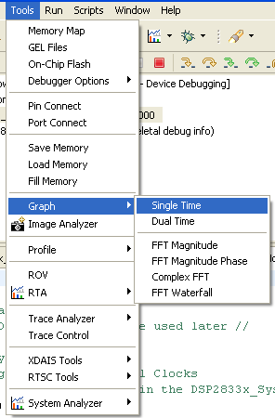
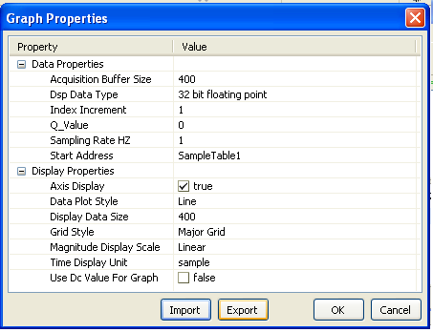
Plot Graph from Cached Data
0
Variable name
or address
Save and load configurations

Slide 31
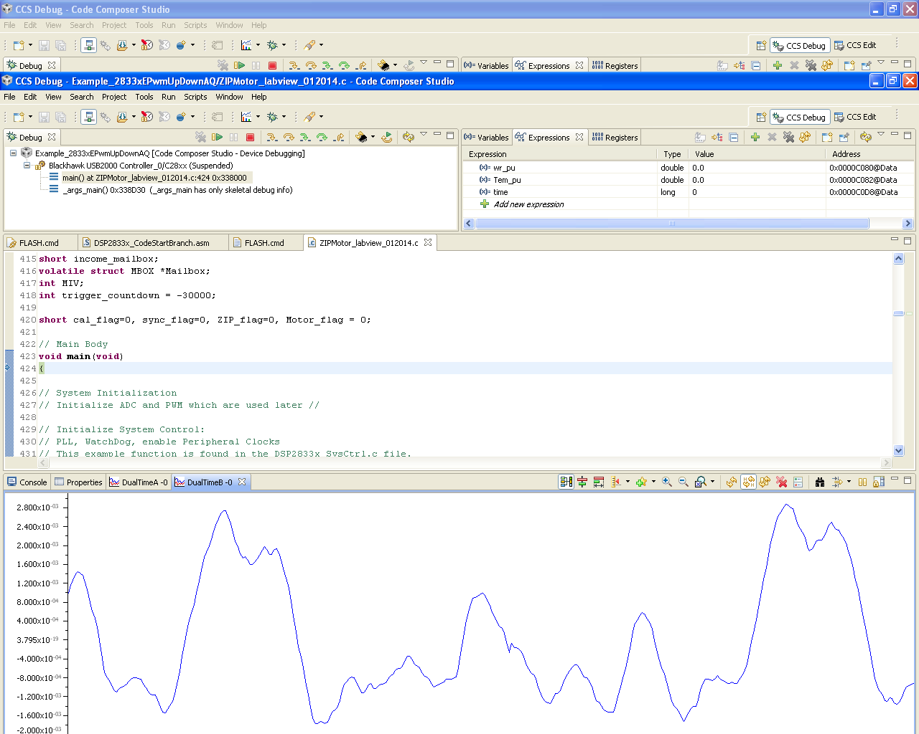
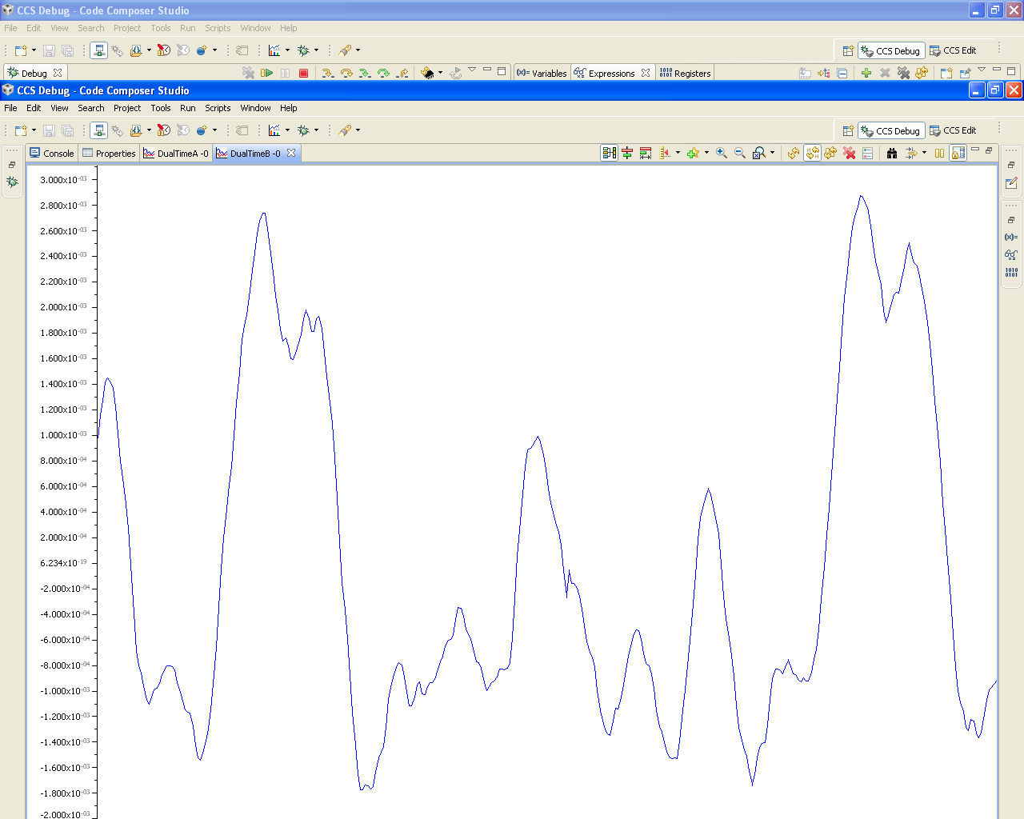
Graph
Double click to enlarge
Modify configuration
Reload
Clear

Slide 32
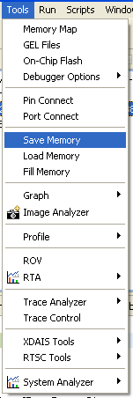
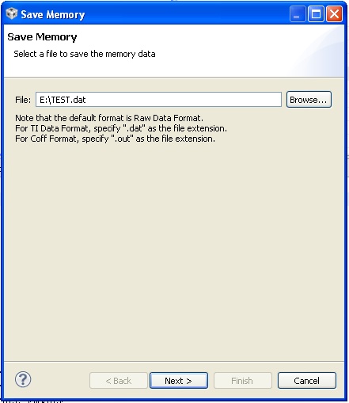
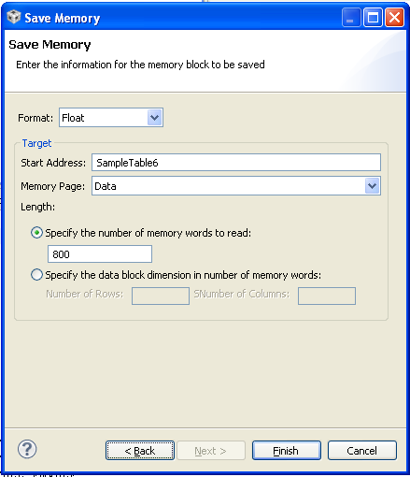
Save Cached Data

Slide 33
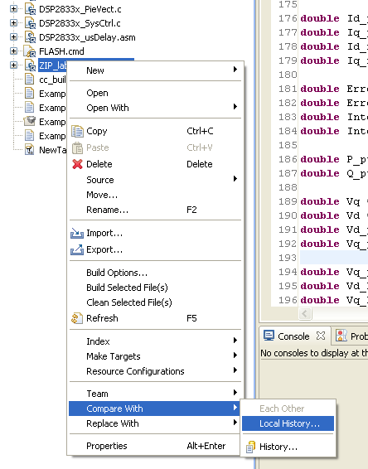
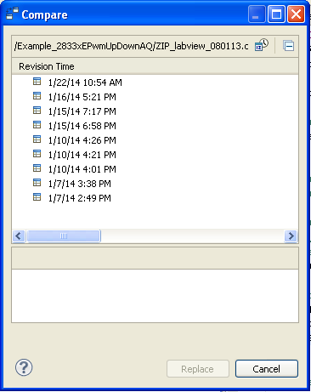
Local History
Especially helpful when you don’t remember what’s modified, or someone changed the program without telling you.

Slide 34
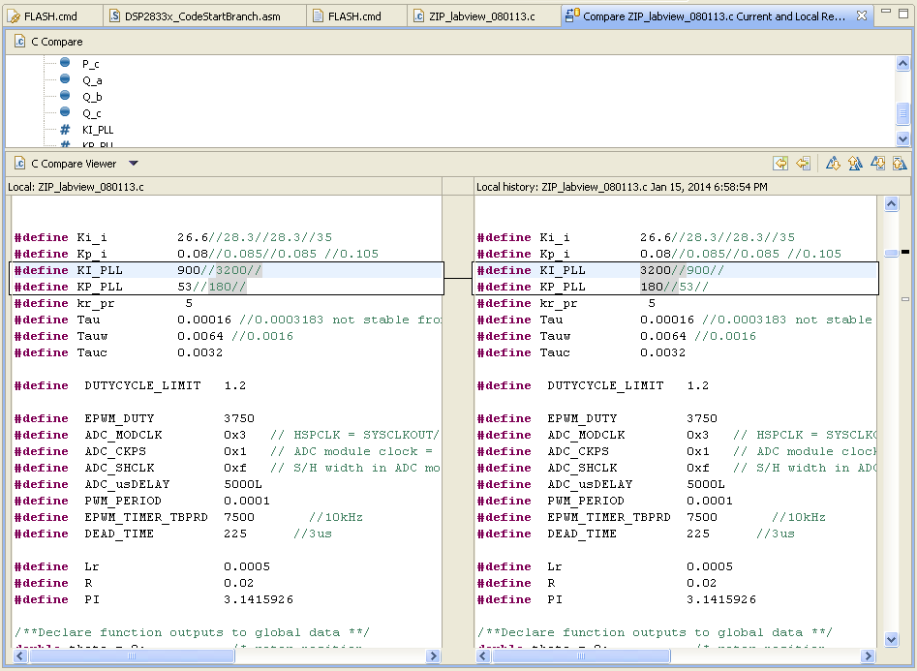
Compare Files
Different places thorough the codes

Slide 35
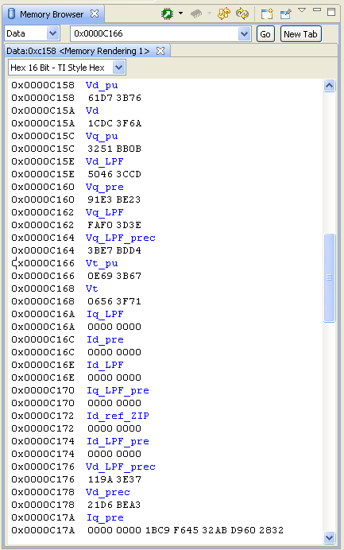
Memory Browser

Slide 36
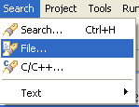
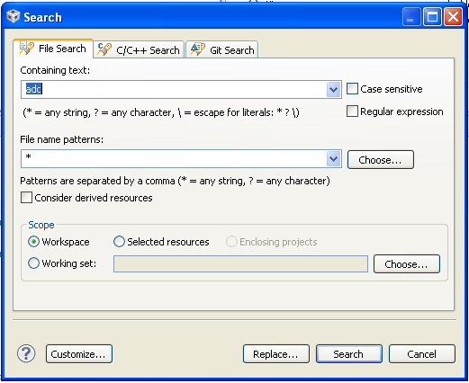
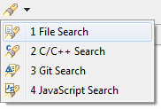
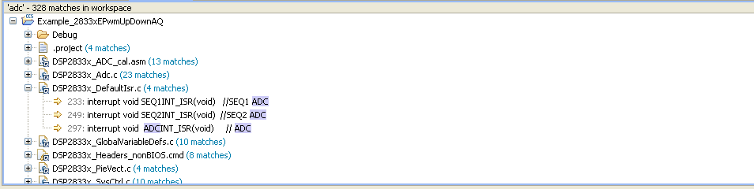
Search All Files in Workspace
CCS 5.5 may not have search tab,
all the same to use the search icon

Slide 37
Useful Shortcut Keys
Ctrl + / // Comment
Ctrl + / again Remove //
Ctrl + Shift + / /* */ Comment
Ctrl + Shift + \ Remove /* */
Ctrl + B Compile and Build
F5, F6, F7 Step over, into, return

Slide 38
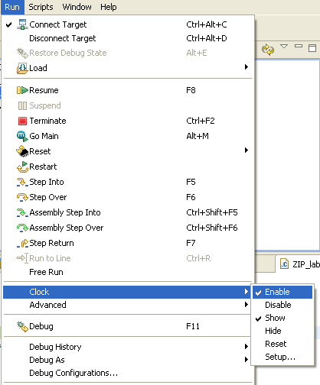
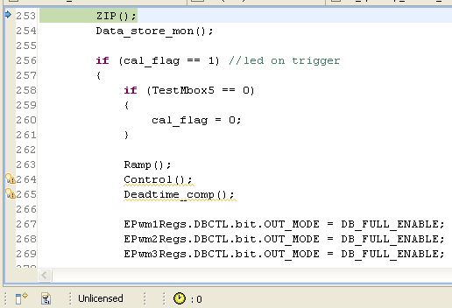
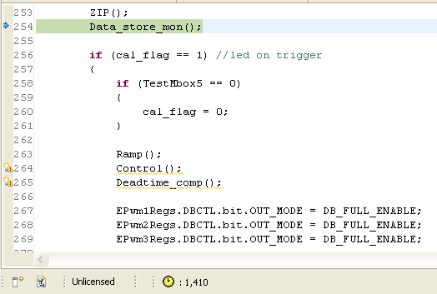
Clock
ZIP() function takes 1410/150MHz = 9.4us to run

Slide 39
Tips to Increase Calculation Efficiency
Use “ * ” instead of “ / ”, use less sqrt() etc.
Calculate only once for frequently used expression
Change library (Ask Bo or Brad)
Homework
  If you are working on a project with DSP programming, please check the running time of your code, and try to optimize it.
Avg = (A+B)/2; | Avg = (A+B)*0.5;
if (sqrt(Vd*Vd+Vq*Vq)<2) | if ((Vd*Vd+Vq*Vq)<4)
Vd = cos(theta)*Vas + ((-0.5)*cos(theta) + 0.866*sin(theta))*Vbs + ((-0.5)*cos(theta) - 0.866*sin(theta))*Vcs; Vq = sin(theta)*Vas + (sin(theta)*(-0.5)-cos(theta)*0.866)*Vbs + (sin(theta)*(-0.5)+cos(theta)*0.866)*Vcs; | c_theta = cos(theta); s_theta = sin(theta); Vd = c_theta*Vas + ((-0.5)*c_theta + 0.866*s_theta)*Vbs + ((-0.5)*c_theta - 0.866*s_theta)*Vcs; Vq = s_theta*Vas + (s_theta*(-0.5) - c_theta*0.866)*Vbs + (s_theta*(-0.5) + c_theta*0.866)*Vcs;

Slide 40
Tips on Programming
Readability
  Comments
    Good example from Zheyu’s double pulse program
  Meaningful variable and function names
  Indentation

Slide 41
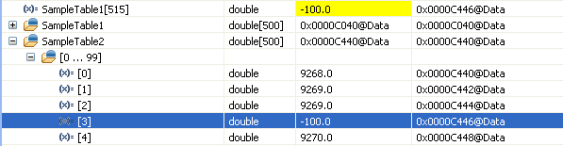
Other tips
Avoid array subscript out of range
Data type of a number
Avoid division by zero

Slide 42
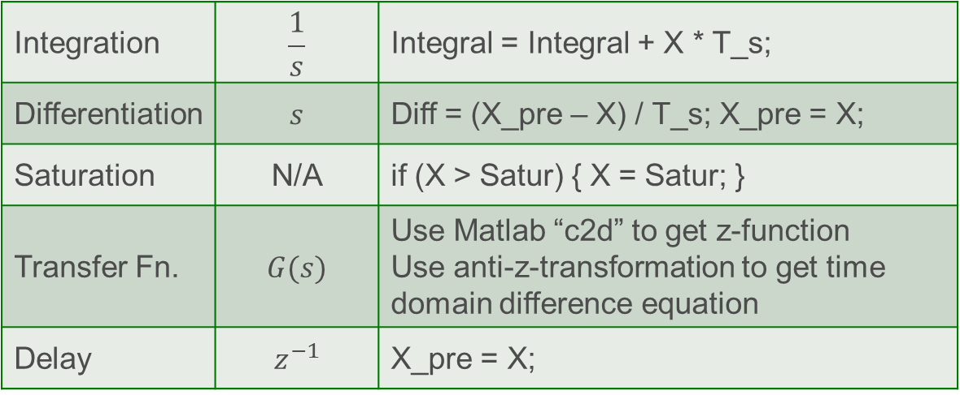
Converting the Continuous Simulation to DSP
How do you write this in DSP?
Integration | $$\frac{1}{s}$$ | Integral = Integral + X * T_s;
Differentiation | $$s$$ | Diff = (X_pre – X) / T_s; X_pre = X;
Saturation | N/A | if (X > Satur) { X = Satur; }
Transfer Fn. | $$G(s)$$ | Use Matlab “c2d” to get z-function Use anti-z-transformation to get time domain difference equation
Delay | $$z^{−1}$$ | X_pre = X;
T_s is the switching cycle / calculation cycle

Slide 43
Debugging with Converter

