Slide 1
Tutorial on Air-gapped Inductor Design
Version | Date | Author | Notes
1.0 | May, 2019 | Zhe Yang | First version; How to design inductor with air gap, consider the fringing effect

Slide 2
Outline
Introduction
Design method
Exemplary MATLAB code

Slide 3
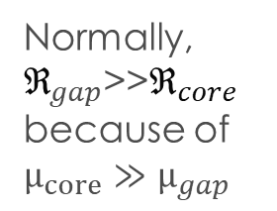
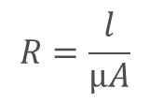
Inductor Design – Modeling
Modeling of inductor – magnetic circuit
Analogy between electrical elements and magnetic elements
$L \text{≈} \frac{N^{2}}{ {\text{ℜ}}_{c,gap}+\frac{{\text{ℜ}}_{o,gap}}{2}}=\frac{N^{2}μ_{0}A_{c}}{ l_{g}}$
$B_{p} \text{≈}\frac{NI_{p}}{ A_{c}({\text{ℜ}}_{c,cap}+\frac{{\text{ℜ}}_{o,gap}}{2})}=\frac{μ_{0}NI_{p}}{ l_{g}}$
Electrical | Magnetic
Voltage, V (V) | MMF (A·T)
Resistance, R (Ω) | Reluctance, ℜ (A·T/Wb)
Current, I (A) | Flux, Φ (Wb)
$$R=\frac{l}{μA}$$
Normally, ${\text{ℜ}}_{gap}$>>${\text{ℜ}}_{core}$
because of $μ_{core}≫μ_{gap}$

Slide 4
Inductor Design – Typical Method
Core geometrical constant (K_{g}) method
Area Product (A_{p}) method
Limitation: fringing effect is neglected
$$K_{g}=\frac{A_{c}^{2}W_{A}}{MLT}≥\frac{ρL^{2}I_{max}^{2}}{B_{max}^{2}RK_{u}}$$
$$A_{p}=A_{c}W_{A}≥\frac{2W_{m}}{K_{u}J_{m}B_{m}}$$
R. W. Erickson and D. Maksimovic, Fundamentals of power electronics: Springer Science & Business Media, 2007.
M. K. Kazimierczuk and H. Sekiya, "Design of AC resonant inductors using area product method," in 2009 IEEE Energy Conversion Congress and Exposition, 2009, pp. 994-1001.

Slide 5
Introduction - Fringing Effect
Magnetic flux spreads out (fringes out) into the vicinity of air gap
Effectively, $A_{c,gap}$ increases, ${\text{ℜ}}_{gap}=\frac{l_{g}}{μ_{0}A_{c,gap}}$ decreases
$L \text{≈} \frac{N^{2}}{ {\text{ℜ}}_{c,gap}+\frac{{\text{ℜ}}_{o,gap}}{2}}$ and $B \text{=} \frac{NI}{ A_{c}({\text{ℜ}}_{c,gap}+\frac{{\text{ℜ}}_{o,gap}}{2})}$ increases
How to account for fringing effect:
Empirical equation: $A_{c,gap}^{′}=\left(a+2l_{g}\right)\left(b+2l_{g}\right)$ a, b are length and width of cross section
Schwarz-Christoffel transformation
J. Muhlethaler, J. W. Kolar and A. Ecklebe, "A novel approach for 3d air gap reluctance calculations," 8th International Conference on Power Electronics - ECCE Asia, Jeju, 2011, pp. 446-452.

Slide 6
Outline
Introduction
Design method
Exemplary MATLAB code

Slide 7
Design Flow Chart - Part I
Part I: for each core in the database, find the min. N and l_{g} that meet L and B requirement
Step 1.1: pick a core k
Step 1.2: for core k, sweep N and l_{g}
Step 1.3: for core k, N_{n} and l_{g,n}, calculate L_{n} and B_{n}
Consider fringing effect in this step
Step 1.4: evaluate L_{n} and B_{n}
If no valid design for core k, move to core k+1 and step 1.2
For valid design, go to step 1.5
Step 1.5: for core k, select the valid design that has lowest N
Move to core k+1 and step. 1.2

Slide 8
Design Flow Chart - Part I
Example: L = 50 μH, I_{pk} = 30 A, B_{max} = 0.4 T
The output from step 1.5 is the minimum N and associated l_{g}
Core # | Core size | Output at Step 1.5 |  | Inductance (µH) | Peak flux density (T)
 |  | Min. turn number | l_{g} (mm)
1 | E 43/21/15 | 21 | 3.6 | 51.9 | 0.40
2 | E 43/21/20 | 16 | 2.2 | 51.8 | 0.40
3 | E 42/33/20 | 17 | 2.4 | 52.9 | 0.39
4 | E 41/17/12 | 25 | 5.8 | 51.3 | 0.40
5 | E 47/20/16 | 16 | 2.1 | 50.0 | 0.40
6 | E 56/28/21 | 11 | 1.3 | 51.6 | 0.39
7 | E 56/28/25 | 9 | 1 | 50.5 | 0.40
8 | E 56/24/19 | 12 | 1.4 | 54.8 | 0.39
9 | E 60/22/16 | 16 | 2.1 | 50.5 | 0.39
10 | E 65/32/27 | 8 | 0.9 | 53.8 | 0.37

Slide 9
Design Flow Chart - Part II
Part II: evaluate each valid design obtained at step 1.5 considering geometry, loss, thermal
Step 2.1: calculate the smallest AWG (thickest wire) by core geometry
Step 2.2: calculate the loss/thermal
Loss and thermal consideration needed
Step 2.3: evaluate the loss/thermal
If meeting requirement, design is considered feasible
Otherwise, design rejected
Step 2.4: select optimal design if multiple feasible designs available

Slide 10
Design Flow Chart - Part II
Same requirement as before
The output at step 2.1: the smallest AWG within geometrical constraint
Use AWG ≤ 10 for thermal and loss consideration in step 2.2
The feasible designs are bold; the smallest inductor is in red
Core # | Core size | Output at Step 1.5 |  | Output at Step 2.1 | Inductance (µH)
 |  | Min. turn number | l_{g} (mm) | Smallest AWG
1 | E 43/21/15 | 21 | 3.6 | 12 | 51.9
2 | E 43/21/20 | 16 | 2.2 | 12 | 51.8
3 | E 42/33/20 | 16 | 2.4 | 11 | 52.9
4 | E 41/17/12 | 25 | 5.8 | 16 | 51.3
5 | E 47/20/16 | 16 | 2.1 | 13 | 50.0
6 | E 56/28/21 | 11 | 1.3 | 10 | 51.6
7 | E 56/28/25 | 9 | 1.0 | 8 | 50.5
8 | E 56/24/19 | 11 | 1.4 | 12 | 54.8
9 | E 60/22/16 | 16 | 2.1 | 10 | 50.5
10 | E 65/32/27 | 7 | 0.9 | 6 | 53.8

Slide 11
Outline
Introduction
Design method
Exemplary MATLAB code

Slide 12
Exemplary MATLAB code
Self-explanatory comments included
Data base includes 27 single-phase EE core and round magnet wire of AWG 0000~29
Run the code and the results are in matrix named ‘result_return’
How to read ‘result_return’
Column 1: core_index
2: AWG number
3: Designed inductance value
4: Maximum flux density
5: Total length of air gap (the length air gap for each psot is half of this result)
6: Turn number
7: Number of turn per layer of winding
8: Number of layer for winding
9/10/11: core/winding/total loss
12: Core volume
13/14/15: Core/winding/total weight

Slide 13
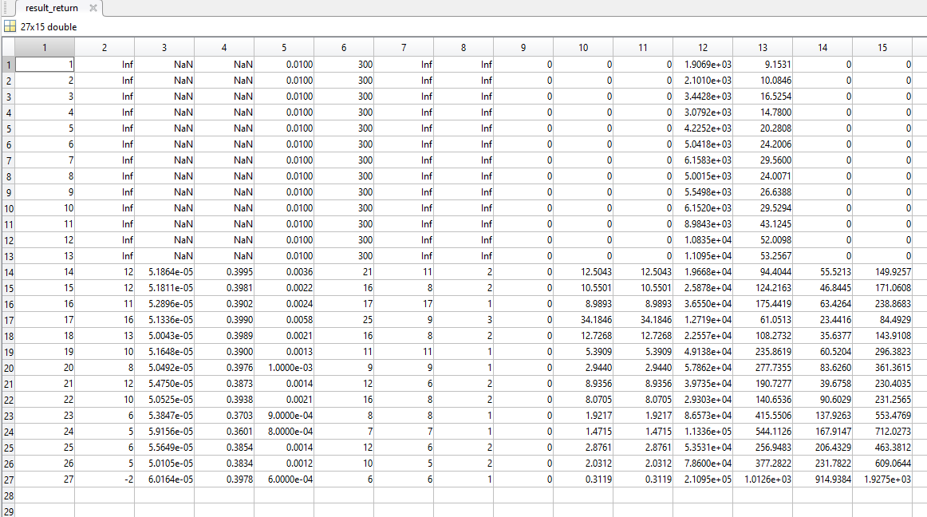
Exemplary MATLAB code

Slide 14
Exemplary MATLAB code
If column 2 (AWG number) is ‘inf’, it means not feasible design for this core
For example in page 13: cores 1~13 do not have feasible design; cores 14~27 have feasible design
Pick a design from row 14~27 that meet your requirement, such as loss budget, AWG/current density requirement, size/weight requirement and etc.

