Slide 1
ECE 627: Wide Area Synchronous Measurement and Applications PSLF Introduction
Steve, syou3@vols.utk.edu
Advisor: Professor Yilu Liu
Power IT Lab, University of Tennessee

Slide 2
Contents
PSLF Introduction
PSLF Demonstrations
View and edit power flow data
Dynamic simulation
PSLF PLOT
EPCL scripts in PSLF
Data conversion between PSS/e and PSLF

Slide 3
Accessing PSLF at CURENT
Log in a server
rd0.eecs.utk.edu (currently available)
rd1.eecs.utk.edu (available after Sept.1, 2016)
rd2.eecs.utk.edu (available after Sept.1, 2016)
Install PSLF on a desktop
Send a request to ithelp@eecs.utk.edu.

Slide 4
PSLF introduction
PSLF
is a software for power system simulations, including steady state and dynamic analysis.
has the capability to simulate large-scale power systems.
includes a large variety of standard dynamic models, including PV, WTG, and HVDC, etc.
more popular in WECC than in EI.

Slide 5
List of component models in PSLF
A large variety of models:
Machine Models
Excitation Models
Prime Mover Models
Stabilizer Models
Transmission Device
Relay and Protection Models
Load Models
Meters
AGC/Power Plant Control Models
HVDC Models
WTG Models
PV Models
Energy Storage Models
User Written Models

Slide 6
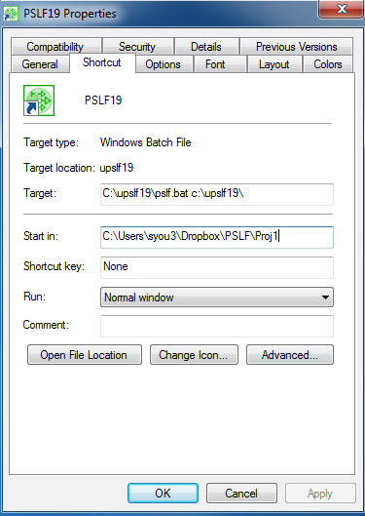
Setting up a working folder in PSLF
The following steps are suggested to avoid changing original cases, script examples, and documents in PSLF.
Create a new folder.
Right click the PSLF shortcut on the desktop.
Change the start directory to the new working folder.
Copy the “samples” folder at the directory C:\upslf19\samples. Paste the “samples” to the working folder. (Optional)

Slide 7
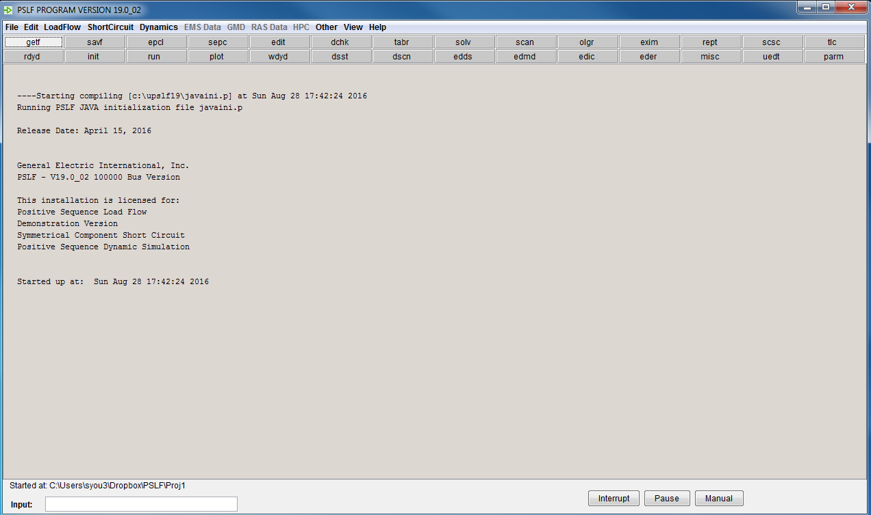
PSLF Main Menu

Slide 8
Getting help in using PSLF
Get help screen for a command by selecting the command and then clicking the F1 key. A typical help screen looks like this:

Slide 9
Demonstrations
View and edit power flow data
Dynamic simulation
PSLF PLOT
EPCL scripts in PSLF
Data conversion between PSS/e and PSLF

Slide 10
View and edit power flow data
Load a load flow case, (e.g. t3ps.sav) using command “getf”.
Use command “edit” to view and edit categorized data in tables.
“solv” to solve a power flow case.

Slide 11
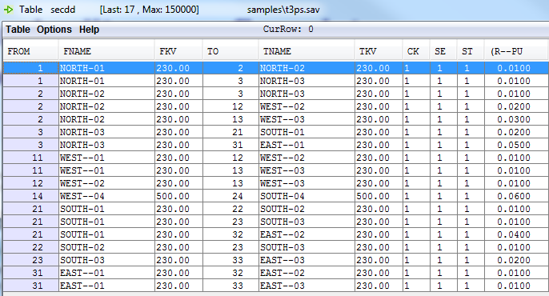
View and edit power flow data - table view or bus display
To create bus display, right click and select “scan record”.
(Both table view or bus display allows editing power flow data).
Table view
Bus display

Slide 12
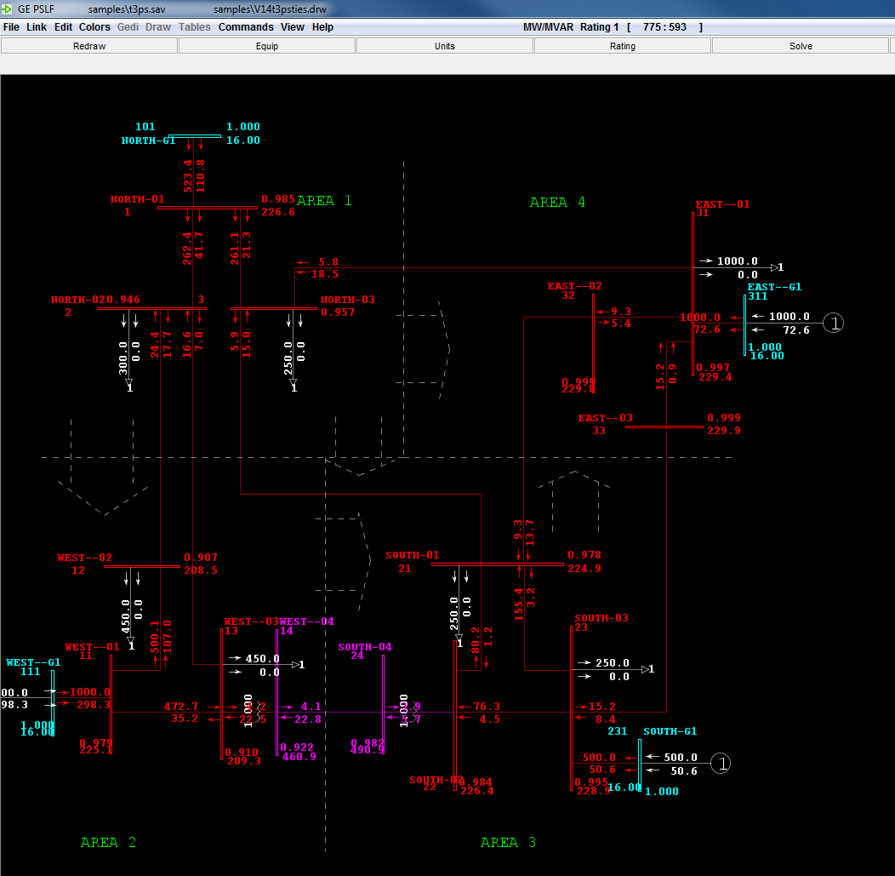
View and edit power flow data – one line diagram
Display the one line diagram.
click “olgr”
“File”-> “open draw”
The one line diagram also allows editing data directly by right clicking components.

Slide 13
Dynamic simulation
Prerequisite: a solved power flow case.
Load dynamic data, (e.g. t3ps.dyd) using “rdyd”.
If editing is needed, click “edds” to view and edit dynamic model types and parameters (right-click the model and select “edit”).
Click “init” to initialize state variables in the dynamic model. (The initialization result will be written into the file with .reg suffix, which is the dynamic simulation error report.)
Click “run” to set next pause time and disturbance parameters; then click OK to run a dynamic simulation.
“dsst” -> stop simulation
“plot”-> plot the results.

Slide 14
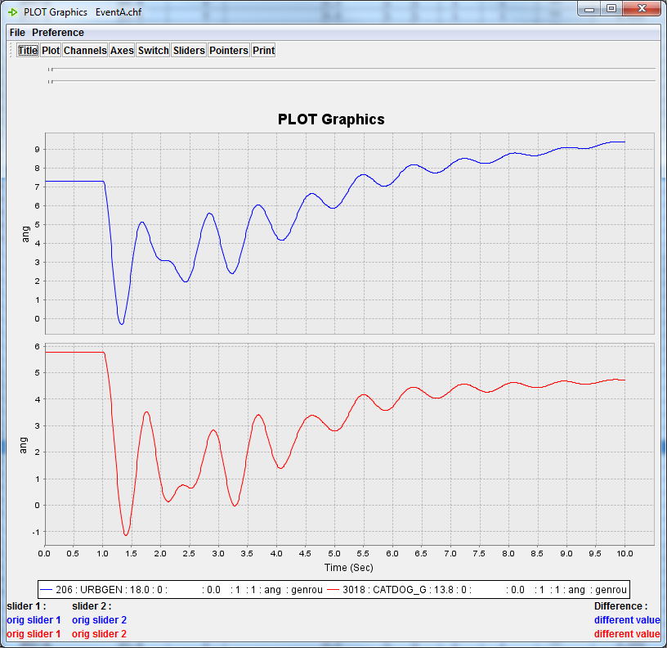
PSLF PLOT
PSLF PLOT is the plotting tool for PSLF.
Plotting steps:
Load the channel file (.chf)
Select plot channels
Right clicking and click plot
PSLF PLOT EPCL
PSLF PLOT has its own manual and a set of EPCL APIs (functions) for result data plotting and manipulation.
Reference: file:///C:/upslf19/htmlpl/Chapter5.htm#Chap5_9

Slide 15
Debugging dynamic simulation suspicions and errors
Click “eder” to load and display the dynamic simulation error report.
The report gives the location and severity of each suspicion or error during dynamic simulation.

Slide 16
EPCL scripts in PSLF
EPCL is to PSLF as Python and Fortran are to PSS/e.
EPCL scripts allows:
Editing and modification of large datasets;
One-click execution of a series of a PSLF manipulations; and
Define user-defined models; etc.
References to write EPCL scripts
EPCL script samples
PSLF EPCL manual
Notes:
You can remember the second tag is EPCL/

Slide 17
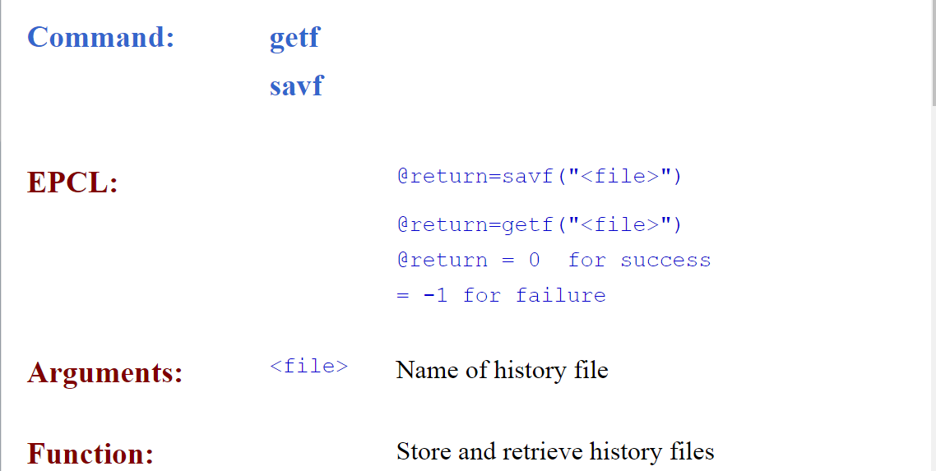
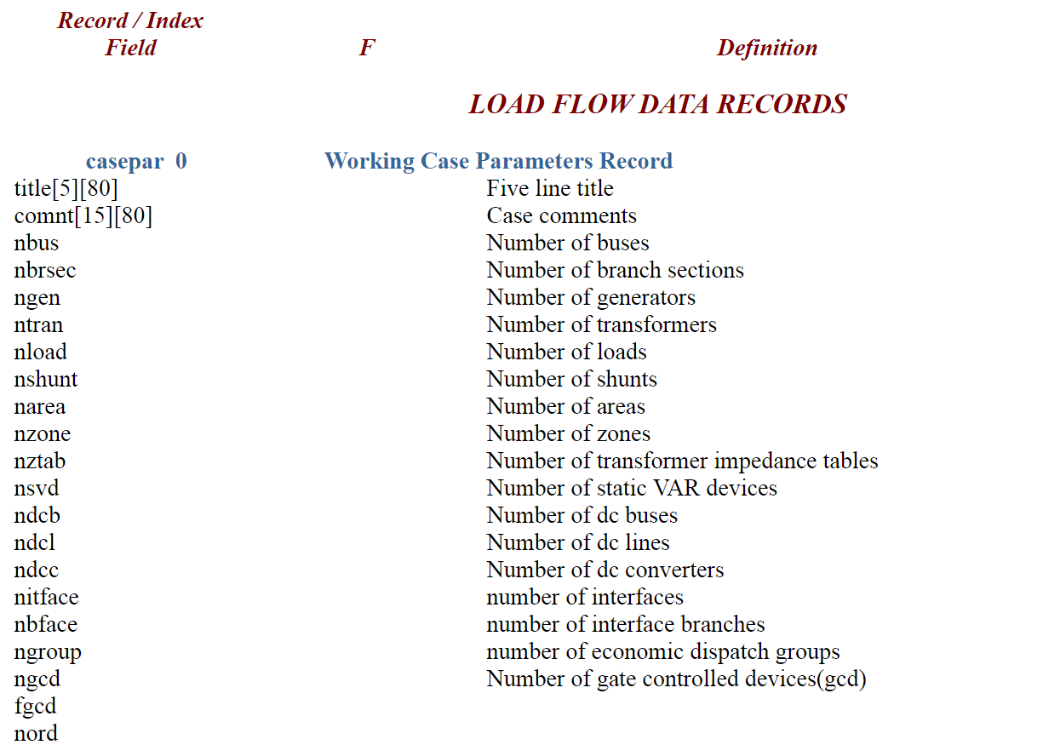
EPCL scripting
EPCL programming knowledge:
Syntax
PSLF APIs
Accessible variables in EPCL
Reference: 1. file:///C:/upslf19/html/toc.htm; 2. file:///C:/upslf19/htmlpl/Chapter5.htm
Functions (example)
Accessible variables (example)

Slide 18
An EPCL example - Dynamic simulation of generation trip event
/* DySim_TripGen_Example.p
dynamic simulation of generation trip event
Trip Gen: NORTH-G1
Trip Time: 1 sec
Total simulation Time:10 sec
*/
$dyfile = "GE23Bus.dyd" /* input dynamic file */
$hfile = "GE23Bus.sav" /* input power flow case */
$pfile = "EventA.chf" /* output channel file */
$rfile = "EventA.rep" /* output report*/
@genTripBus1 = 101 /* select bus of generator to trip */
(variable definition)

Slide 19
An EPCL example (cont.)
@return = getf($hfile) /* load power flow case data*/
@return = rdyd($dyfile, $rfile, "1") /* load dynamic data*/
@return = soln("0") /* solve load flow */
@return = init($pfile, $rfile, "1") /* initialize */
/* run 1 sec of steady state simulaiton */
dypar[0].tpause = 1.
@return = run()
/* find the internal bus index of the gen trip bus*/
for @i = 0 to casepar[0].nbus-1
if( busd[@i].extnum = @genTripBus1 )
@genbus1 = @i
endif
next
(solving load flow and initialize dynamic simulation using PSLF APIs)

Slide 20
An EPCL example (cont.)
/* Trip unit*/
for @i = 0 to casepar[0].ngen-1
if( gens[@i].ibgen = @genbus1 )
gens[@i].st = 0 /* set the gen status to ‘off’*/
endif
Next
/* run simulation to 10 sec */
dypar[0].tpause = 10.
@return = run()
end
(manipulating system states using EPCL syntax and accessible variables)

Slide 21
Data conversion between PSLF and PSS/e (PTI) formats
Convert PSS/e (PTI) to PSLF:
Click “Exim” to import PTI power flow data (.raw).
Execute the EPCL script: rdyn.p to load PTI dynamic data (. dyn).
Click “savf” and “wdyd” to save data in the PSLF format.
Issues may happen due to model compatibility between PSLF and PSS/e. To solve them, please read “samples\Dynamic Data Conversion\Dynamic Data Conversion.doc”.

Slide 22
Some exercises
Load the power flow data using a test system in PSLF (e.g. “t3ps”). Try editing the power flow data, creating bus display and loading one-line diagram.
Perform dynamic simulation (bus fault, line trip, or generator trip). Check the error report and plot simulation results in PSLF PLOT.
Write a EPCL script to automate the simulation in 2.

